Slide 1


UPS Mid-Semester Check in
Notes:
Hey everyone, welcome to our final presentation for the UPS project today. After a whole semester of work regarding the project, we are able to provide a thoroughly presentation regarding the improvement of efficiency of UPS delivery. During the presentation, feel free to interapt if you have any questions.

Slide 2





Introduction of the Team
Neel Mirani QSS/Econ
Xiuyi Qian
QSS/Info
Yijun Shen QSS/Econ
Christina Ding
AMS
Marawan Elgohry
QSS/Econ
Notes:
First, I am going to introduce the team members. Neel xiuyi and Marawan and myself Yijun are emory students majoring in Quantitative Science with different tracks, and Christina Is majoring in AMS. We were all involved in the project and this presentation for today.

Slide 3
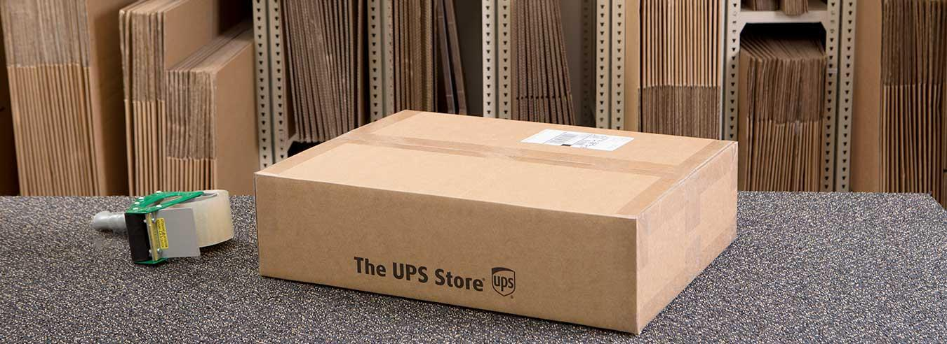
Problem Statement
How much does it cost (time) and how can we minimize the cost for UPS to deliver one extra package at a stop?
Notes:
Time is precious. Especially in the business world, a few seconds differences can result in a huge consumers satisfaction differences. So the problem we are trying to solve through this research is how much does it cost to delivery packages and how can we minimize the time consumption for UPS to deliver one extra package at each stop.

Slide 4

About the Dataset
1
Notes:
First, we are going to walk through the dataset and the cleaning process of ours.

Slide 5
DATA - Structure and Size
Datasets Initially:
August primary Data
September primary Data
October primary Data
August alternative Data
September alternative Data
October alternative Data
About each dataset:
37 variables,
On average each has about 2,300,000 observations,
Index number cannot be used for the original datasets.
Notes:
Originally, we were given six different datasets: one primary dataset and one alternative dataset for the months of August, September, and October. Each original dataset contain 37 variables, and on average about 2.3 million observations. We could not use the index number provided with the original data since there are a lot of duplicated index and error in those datasets. So we decided to clean and merge the dataset.

Slide 6
DATA - Merging and Cleaning
Important Merging Steps
Merge primary and alternate for each month by the “unique” variable
Merge 3 days of data into 1 (～7 million obs)
Important Cleaning Steps
Stop Time negative values, >10 hrs removed​, convert (s)
Location Description to binary
>10 Packages delivered removed
Stop Time 2 removed
Notes:
≥/In order to merge all of this data into one dataset, we first merged the primary and alternative dataset for each month by the variables unique, which is a variable we created as the new index variable. This resulted in one dataset for each month (3 total) that only contained observations that were in both the primary and alternative dataset. We found that a lot of the columns were repeated, so we then got rid of all repeated columns. Next, we used the rbind function to aggregate all 3 separate datasets into one; at the end, we have a 2GB dataset with around 7,000,000 observation. During the cleaning process, we removed some observations that do not make sense. Such as negative stop time for package delivery, stops time that is over 10 hours, and the stop time 2 variables, because the variables contain mostly negative and zero values. We also made a feel modifications. We change the delivery time each stop from hour to seconds to make it more precise, and switched location description into binary variables, which is easier for us to conduct regression analysis.
Maasurement of time 2 not current
Driver day- track driver over days so we are able to control the character of the driver
On average, each driver stop 130 stops each day

Slide 7
Summary Statistics
2

Slide 8
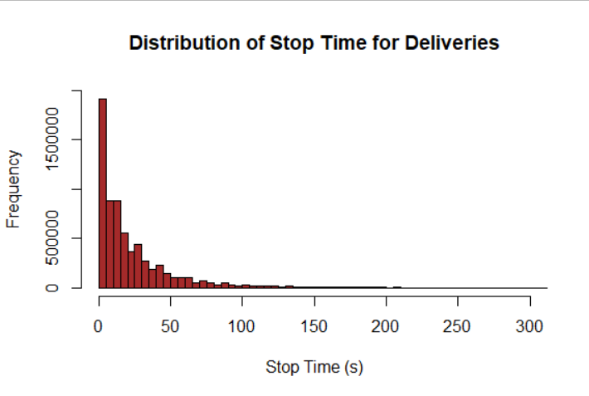
Dependent Variable: Time at Stop
Notes:
Explain what graph is showing
What is x axis unit: seconds
What is y axis
What does this mean
Summary Stats:
Min. 1st Qu. Median Mean 3rd Qu. Max.
1.20 4.80 13.80 42.11 33.00 33739.80
Most of the stop cost time less than 100 seconds (around a minute and a half)
The first quantile is around 5 seconds and third quantile is around 33 seconds
The maximum stopping time cost 33739.80
As we have mentioned before, the model we have been building on is based on the filter data which exclude outliers to make sure the left stopping time make sense

Slide 9
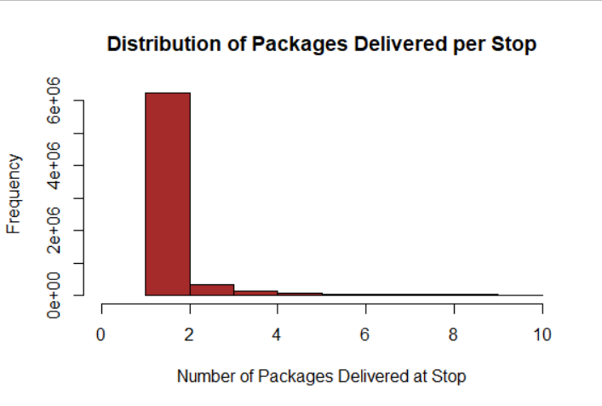
Independent Variable: Number of Packages Delivered
Notes:
Summary Stats Discussion:
Min. 1st Qu. Median Mean 3rd Qu. Max.
1.000 1.000 1.000 1.473 2.000 10.000
Histogram Explanation
Not considering >10 pkgs: 1.1%
Filter out the data,only include the number of packages under or equal to 10 at each stop
The reason why the maximum x value is up to ten is because we have also filtered the data
The filtered data occupy 1.1 percent of our total datasets
Corresponding to the time distribution we have covered in the last slide,

Slide 10
Covariates
Important Covariates:
Packages over 70 pounds Zoning – commercial vs residential
Human Interaction
Other Covariates :
Driver’s type
Bonus
Time of day – morning, afternoon, evening
Driver tenure
Notes:
over 70: create one dummy variables for this model
over 70: stops with very heavy pacakge ==1
Classify into three categories
Package driver majority/ combination driver / other driver
Human interaction: if the driver needs to counter with customers for example ask for the signature
There are also four other covariates we had considered and discussed
Before 12: morning
Afternoon: 12~2:
Evening: 2~
Tenure: how many years having been UPS driver

Slide 11
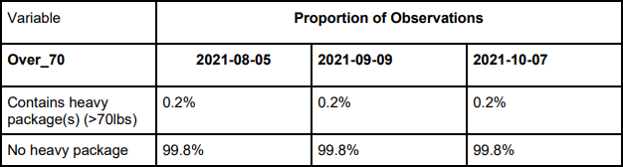
Covariate 1:
Over 70 Ibs
The stops containing heavy packages(Over 70 pounds) are around 0.2% of all stops for all three months.

Slide 12
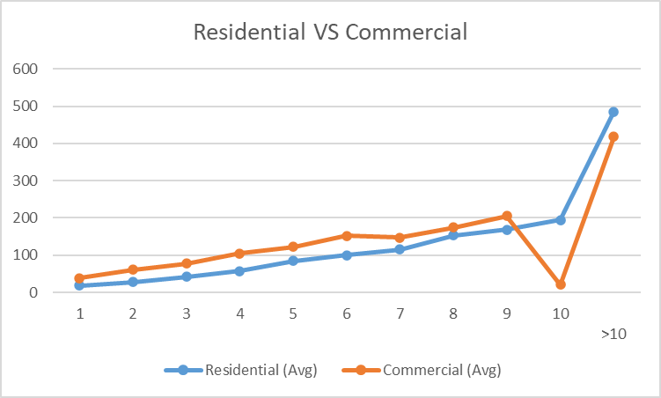
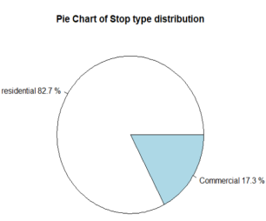
Covariate 2:
Zoning
Notable Findings:
There are significantly more residential stops than commercial stops
Commercial stops, in most cases, cost more time than the residential ones.
Notes:
Title of table
Detailed conclusion
Only average
Overall comparison of residential and commercial
Make two line graph for commercial and residential

Slide 13
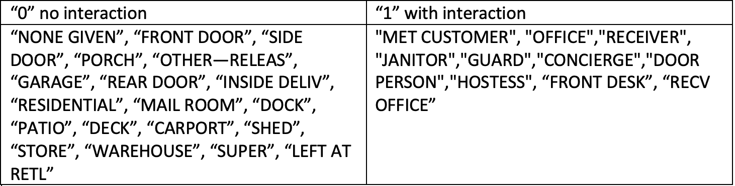
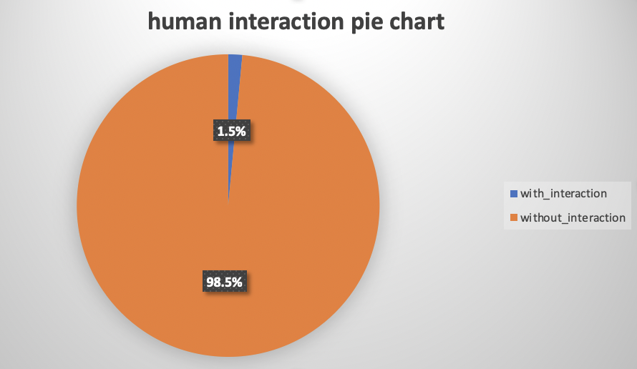
Covariate 3:
Human Interaction
Notes:
Which 0 which 1
Pi chart
Mean 0.01376
, percentage

Slide 14
Initial Regressions
3

Slide 15
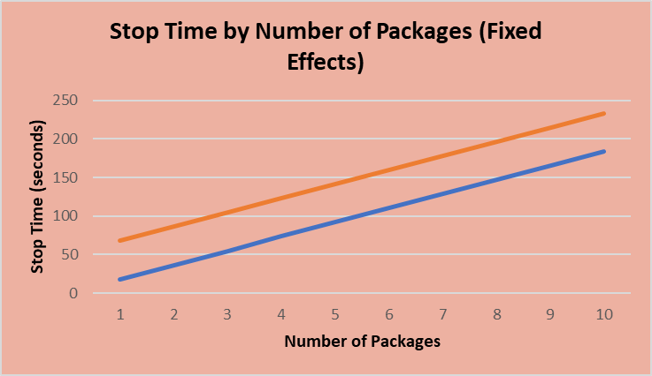
Simple Model w/ Fixed Effects
Stop Time = driver fixed effect + 18.3（number of packages) + Error
Driver 1
Driver 2
Notes:
Observe multiple stops for driver -> fixed effectsy
Y = fe + 18.3x
Homogeneous slope: 18.3

Slide 16
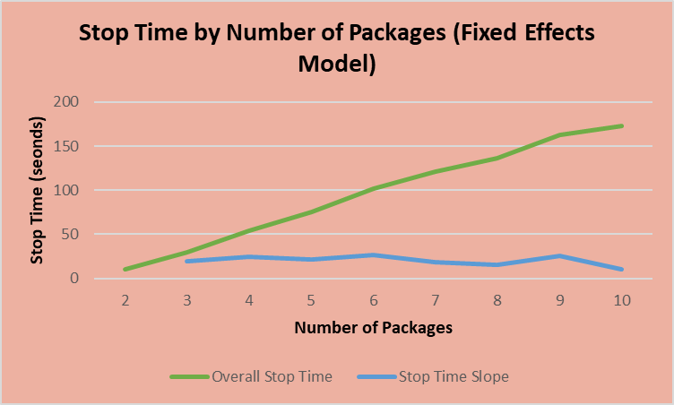
Flexible Model w/ Fixed Effects
Stop Time = driver fixed effect + 10q2 +29q3 +54q4 + 75q5+ 102q6 +121 q7 +137 q8+ 163q9 + 173q10 + Error
qj = dummy =1 for stops with j packages.
Notes:
Flexible: allow slope to be different between different numpackges
By including dummy variables: include equation: analogous to previous slide w/ respective slopes per numpkgs
Slope is pretty homogenous: overall conclusion

Slide 17
Covariate Regressions
4

Slide 18
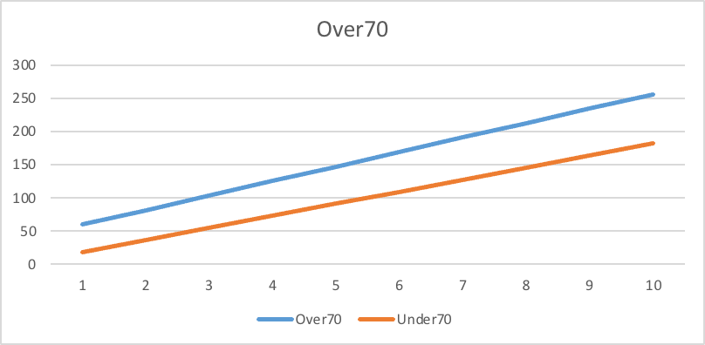
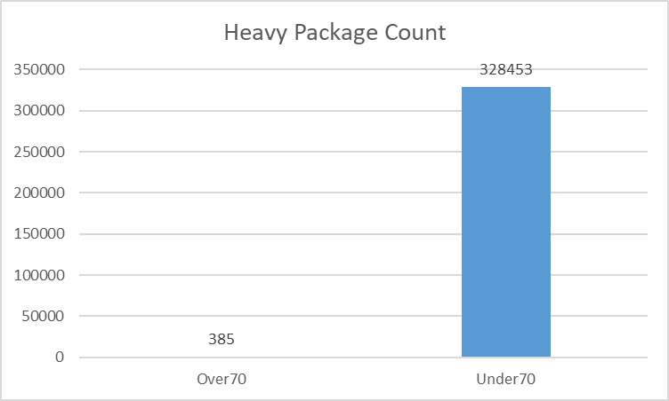
Covariate 1:
Over 70 Ibs
Formula:
Stop time = B₁*(package quantity) + B₂*(package quantity * Over70) + B₃ *(Over70)
Variable Explanations:
Over70: Stop with Over70-Package
Under70: Stop without Over70-Package
Results:
Slope of packages under 70 Ibs (B₁): 18.2 seconds per package
Slope of packages over 70 Ibs (B₂): 21.5 seconds per package
Intercept difference (B₃): 38 seconds
Notes:
Don’t write as r code: math eqn
Diff between lines: y intercept and slopes
Difference between slope and intercept

Slide 19
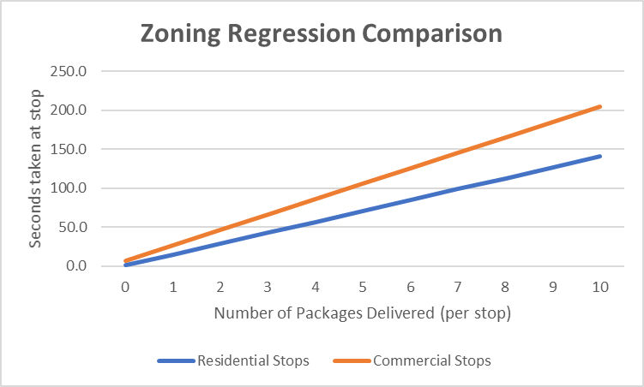
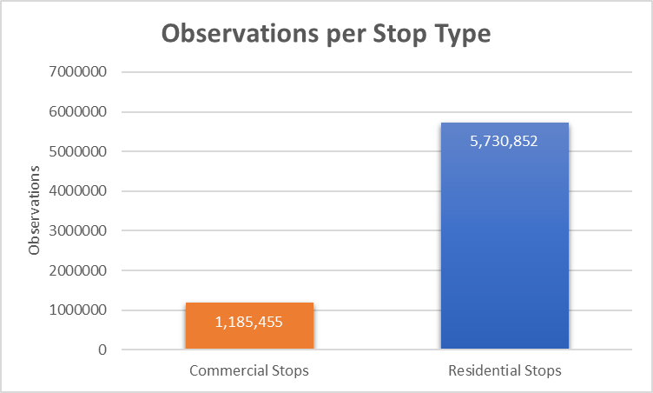
Covariate 2:
Zoning
Variable Explanations:
2 kinds of stops: residential and commercial
Formula:
Stop time = B₁*(package quantity) + B₂*(package quantity * commercial stop) + B₃ *(commercial stop)
Results:
Slope of packages in residential areas (B₁): 13.9 seconds per package
Slope of packages in commercial areas (B₂): 19.8 seconds per package
Intercept difference (B₃): 14 seconds
Notes:
Takes value of 0 for residential, 1 for commercial

Slide 20
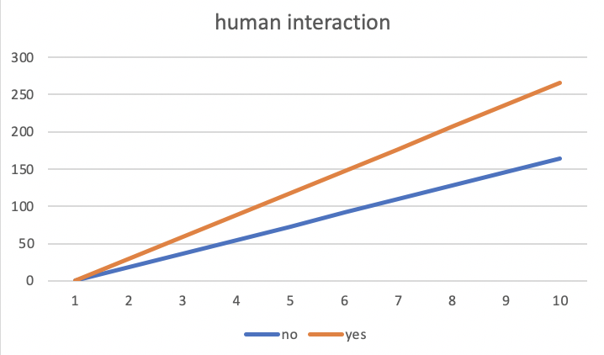
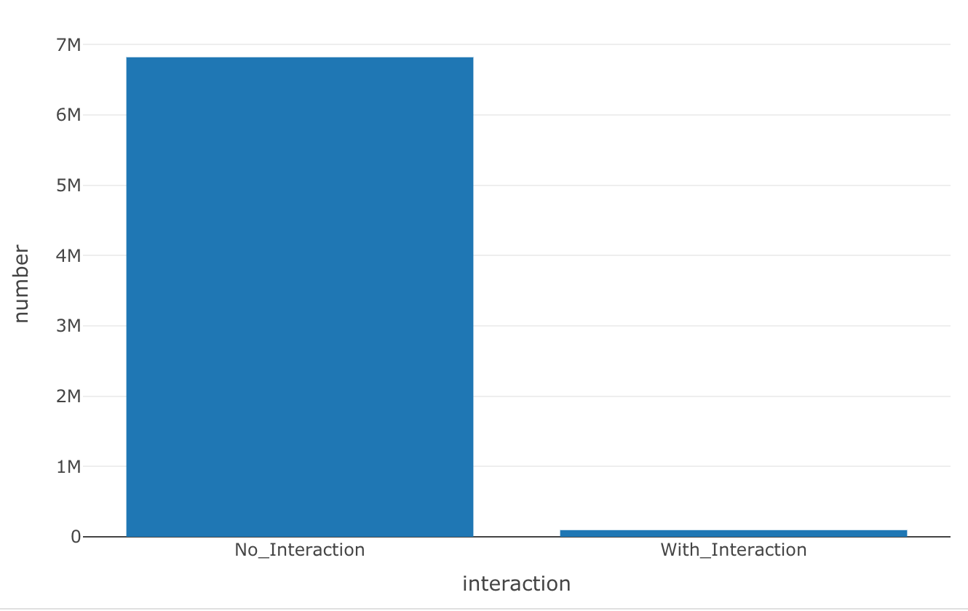
Covariate 3: Human Interaction
Formula:
Stop time = B₁*(package quantity)
+ B₂*(package quantity * human_interaction)
+ B₃ *(human_interaction)
Variable Explanations:
yes: Stop with human interaction
no: Stop without human interaction
Results:
Slope of packages without interaction (B₁): 18.3 seconds per package
Slope of packages with interaction (B₂): 29.5 seconds per package
Intercept difference (B₃): 11.14 seconds
Notes:
Discuss the covariates we looked at but didn’t work on:
Bonus
Tenure
Driver Type
Time of Day

Slide 21
Results and Conclusions
5

Slide 22
Key Takeaways
1: Overall, there appears to be a marginal increase of 18 seconds in stop time with each additional package
2: The covariates relating to weight, stop zone, and human interaction have significant effects on a stop’s time

Slide 23
Questions?
X

